Slide 1
OpenShift 4.x Architecture Workshop
Digital Transformation with API´s
July 2019

Slide 2

MORE SOFTWARE: INCREASING DIGITAL TOUCHPOINTS
MORE INDEPENDENTLY DEVELOPED, SILOED, CUSTOMER FACING APPS
43%
have 10 or more digital touchpoints
8%
have 100 or more digital touchpoints
Source: Henry Peyret for Forrester, Brief: Architect For Digital Operational Excellence, Aug 2016.
https://www.forrester.com/report/Brief+Architect+For+Digital+Operational+Excellence/-/E-RES132241
Notes:
S2 market situation: What is happening in this area - what is the reason we are having this conversation?
““Many EA pros... need to account for a high number of independently developed, siloed, customer-facing apps. In fact, 43% of businesses have 10 or more of such digital touchpoints, with 8% having 100 or more.”

Slide 3
API Management Needs

Slide 4
APIs ARE...
Mission critical to every business (or soon every business)
Customers and partners depend on it
Fundamental to company agility and competitiveness
Web and mobile depend on APIs
Notes:
We know that businesses are rapidly increasing their use of software for innovation. We know that APIs are the state of the art unit of interface between businesses and between a business and it’s customers.
We know that they’re competitiveness, agility, and their ability to deliver application content on the web and on mobile devices depend on APIs.

Slide 5
APIs ARE FUNDAMENTALLY HARD TO DO
Business results challenges (key metrics, onboarding audience, support, docs, policies, business model)
Technical challenges (design, performance, …)
Operations challenges (uptime, versions, security, alerts, analytics, rate limits)
Notes:
So of course, there are some roadblocks to capitalizing on an API strategy.
Often most formidable challenges are business challenges: can the product managers choose and bring to the surface the right metrics? Can the product managers gain mindshare inside the company? Can the product managers create a community of developers at scale? Is the company in a position to foster and support that community? Can a business model be sustained and profitable?
Beyond that are the technical challenges present in any software project of similar size and complexity: can I design it so that it performs adequately at scale. Will it truly offer the value that I think it does
And of course, as an ongoing business, it will have operations challenges around uptime, versions, security, alerts, analytics, rate limits

Slide 6
What problem do we solve?

Slide 7
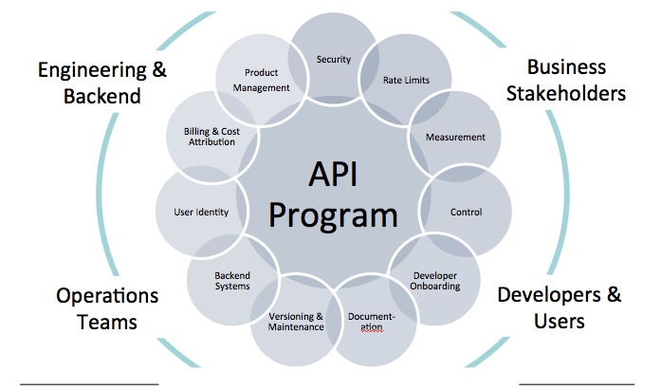
ASPECTS OF AN API PROGRAM
Good API development and API management Technology allows customer to focus on business goals and policies
Notes:
So where does Red Hat’s API technology fit in to this cycle? To answer in terms of the earlier slide: we help you solve the technical and operational challenges, and we help you measure, monitor, and optimize the business challenges.
In the area of fostering a community of developers, we offer an extensible portal with documentation and testing tools.
In the area of operations, we offer integration of backend systems, security enforcement, versioning and maintenance.
In the area of business management, we offer policy enforcement, billing, key performance indicator monitoring, and rate limiting

Slide 8
Why Red Hat for API´s ?

Slide 9
AGILE IN INTEGRATION
Make your platform—not just your software—agile
Agile integration
The application of the agile methods and practices for the purpose of integrating systems, using platforms specially suited for the principles both of agile software development and for productive integration.
Integrating services, apps, APIs and data in an agile way is a solid foundation for competitive advantage
Notes:
To understand what makes Red Hat special as an API partner, I’d like first talk about what makes us special to agile developers, who are driving a lot of the innovation in our industry today.
Agile as a development methodology has existed now for almost twenty years - Source: www.agilealliance.org/agile101/
. Our claim is that there is a special case of Agile development focused on integration, which we call Agile Integration. Agile Integration is… (read definition)
This turns out to be what makes companies great at innovating.

Slide 10
KEY CAPABILITY OF AGILE INTEGRATION APPROACH
Key foundational capabilities for modern software infrastructure
DISTRIBUTED INTEGRATION
CONTAINERS
APIs
-Lightweight
-Pattern-based
-Event-oriented
-Community-sourced
- Cloud-native solutions
-Lean artifacts, individually deployable
- Container-based scaling and high availability
-Well-defined, reusable, and well-managed endpoints
-Ecosystem leverage
FLEXIBILITY
SCALABILITY
RE-USABILITY
Tools and processes
Notes:
Many technologies contribute significantly to IT agility. However, in observing the successes of many customers in the past five years there are three which stand out as truly transformational in what they help organizations achieve.
Distributed Integration: Integration has long played a fundamental part in Enterprise systems, but it is the ability to move integrations to wherever they are needed in an organization allowing diverse teams to own their own integration, which represents the enormous increase in agility.
Containers: containers are now well on their way to being the clear choice for many organizations as their unit of deployment for all systems. Containers, especially with today’s sophisticated container management tools, provide a stable, verified, quickly deployable and easy to update unit of deployment.
APIs: stable, well managed APIs in an organization have a huge effect on collaboration between teams and between development and operations. Wrapping key assets in stable, reusable interfaces creates the right level of building blocks for reuse across the organization, with contractors, with partners and with customers.

Slide 11
RED HAT 3SCALE API MANAGEMENT
Key capabilities
Control
Security
Key management
Rate limiting
Policy enforcement
App and user management
Provisioning
Visibility
Analytics
App tracking
User tracking
Traffic alerts
Engagement
Developer support
Flexibility
Distributed
Multi-department
Multi-environment
Highly scalable
Powerful APIs
Webhooks
Notes:
The Red Hat 3scale product gives you the control, visibility and flexibility you need to create and deploy and API program.
In an earlier slide, we presented some product features organized around organizational needs. These features fall under the control and visibility aspects of your project.
We we didn’t mention is that 3scale has those features, but it is designed to adapt to your business seemlessly and grow with you. You can easily distributed it throughout your organization, in multiple departments. It can participate in proper devops pipelines. It is completely configurable and manageable through a published set of APIs, and it provides webhooks so that events detected in 3scale can trigger any business or automated process that makes sense for your organization. So for example, you can define your own business process outside 3scale that is triggered by a violation of a rate limit by one of your consumers. Maybe send them an email or something.

Slide 12
KEY DIFFERENTIATORS
Flexibility/scalability: Hybrid architecture, separation of policy management from control nodes, highly scalable
Quick time to value: Up and running quickly using the SaaS product
Automation: APIs, code management for configuration, ready for Ansible/Puppet/Chef, integration coming with OpenShift
Cost-effective: Significantly cheaper, in general, than competitors for equivalent volumes
Notes:
What do we do better/different?
Some competitors are either on prem or SaaS. We support hybrid architecture, and 3scale is highly scalable
Easy trial, and simple interface yield very fast time to value
Product is entirely controlable via APIs
More attractive pricing than competing products.

Slide 13

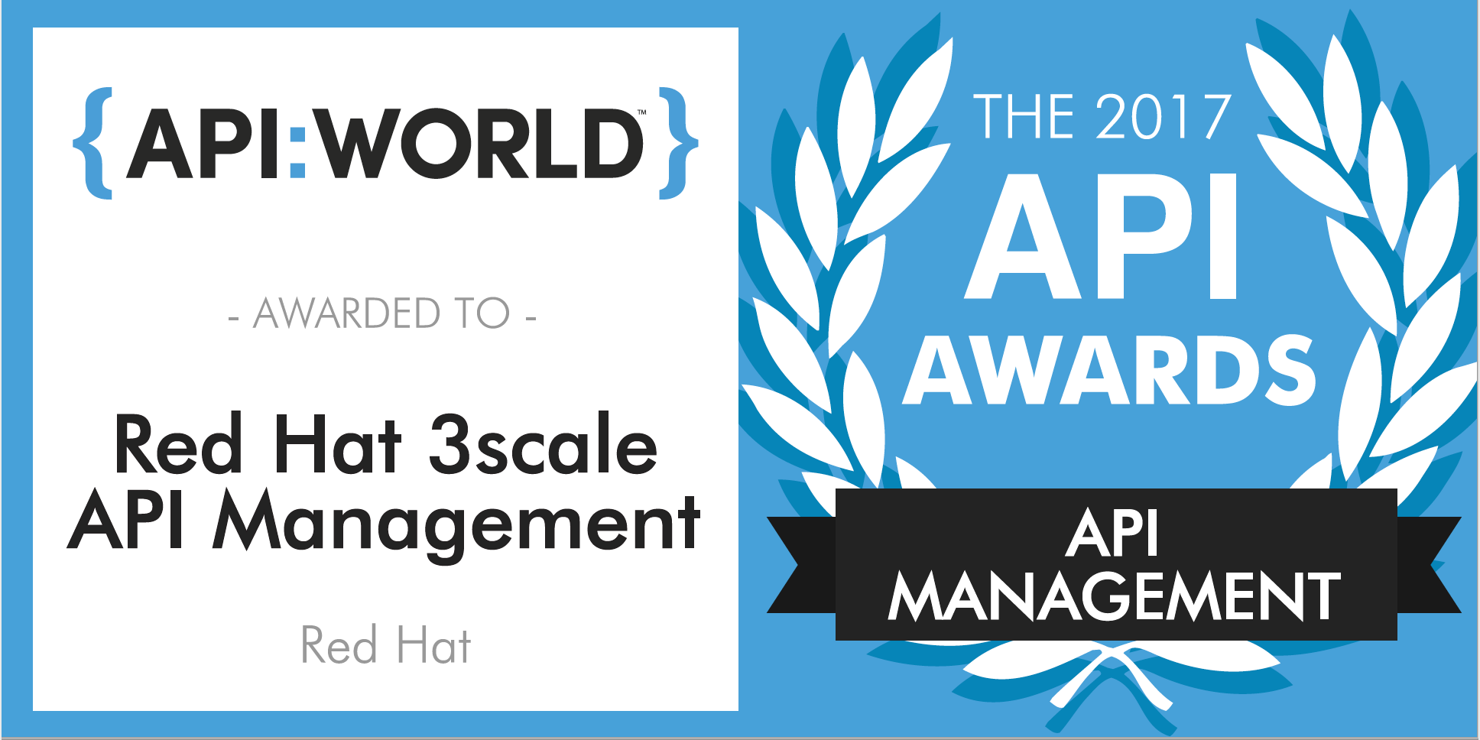
AWARD WINNING INNOVATION
Leader in Gartner Magic Quadrant for Full Lifecycle API Management (2016)
CODiE 2017, 2018 SIIA award: Best API Management Platform
2017 API World award: Best API Management Platform
Notes:
In the last year along, 3scale has won the top API management awards from two separate organizations, as well as being favorably recognized by Gartner and Forrester.

Slide 14
Feature Overview

Slide 15
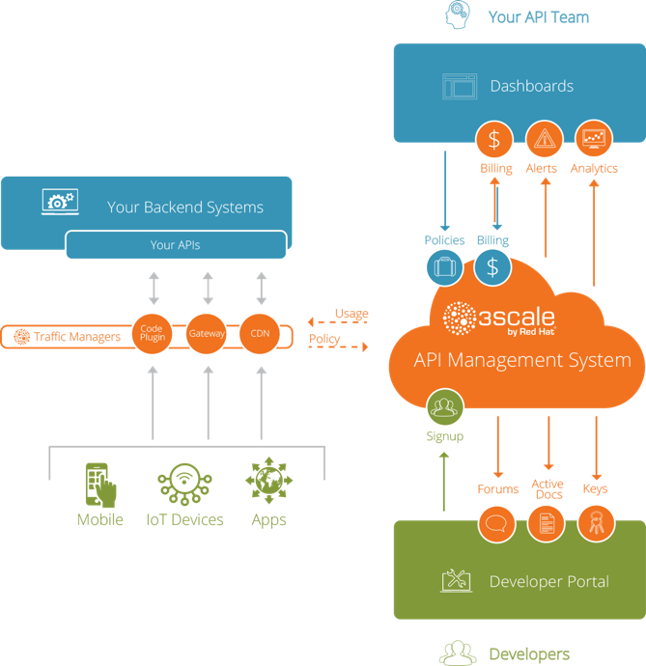
Flexible distributed control
Modular
No single point of failure
Hybrid cloud access
Highly scalable
Notes:
Before we go into more details regarding the 5 core features, it’s important to emphasize a few benefits:
One of the key differentiating factors of the 3scale API management solution is the unique hybrid-cloud architecture. This is achieved by a logical separation of concerns into two main elements: -
- the API management policy execution (“traffic managers” aka API Gateway)
- with the API management policy configuration (“API management system”)
Both these elements communicate with each other in an asynchronous fashion, leveraging caching on the API gateway. The advantage of this unique setup is that if the API management policy configuration element is not available, the whole API program is still fully functional.
A consequence of this is increased performance and very little latency because API calls do not have to be routed though the 3scale cloud infrastructure. The call flow and with that the customers data never leaves the customer’s premise.
A second benefit is that with 3scale the API provider gets a rich API admin portal including performance dashboards, and developer facing portals for exposing and documenting APIs.
Additionally, customers with Enterprise subs get access to all the 3scale features via APIs as well.

Slide 16
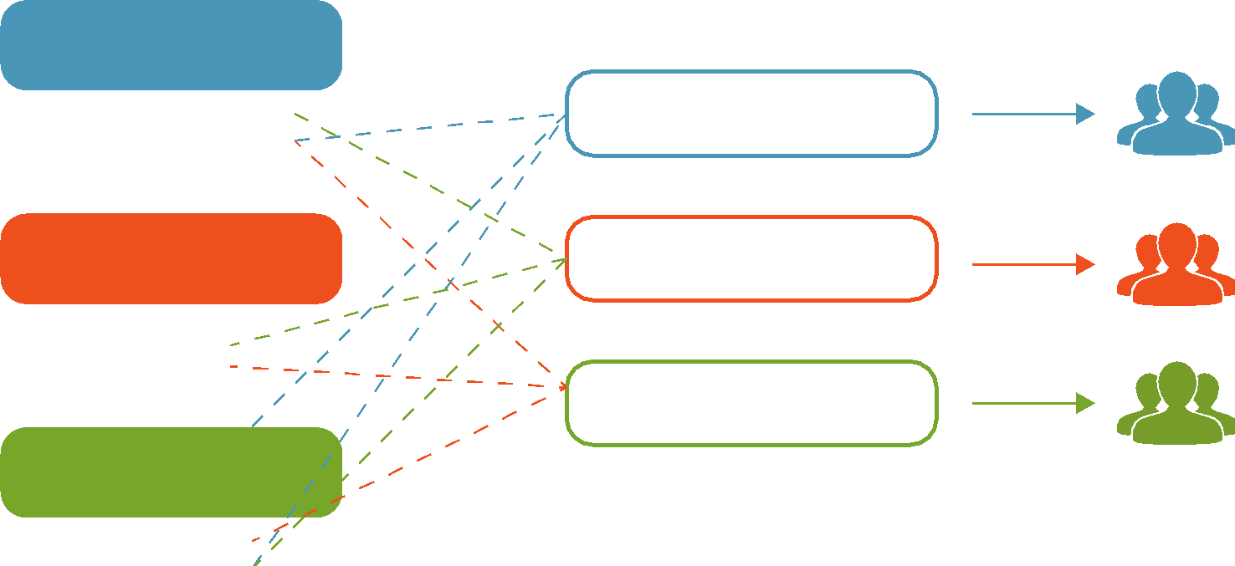
API contracts and rate limits
Package your APIs. Create access tiers. Set rate limits.
Allow/restrict access to your API endpoints along with rate limits.
API services
Package #1
Internal teams
- Endpoint A - Endpoint t B
Rate limits
Package #2
Strategic partners
- x calls / minute - y calls / day
Package #3
Developers
Monetization
Free
$x per month
$y per call
Notes:
The second key feature is the ability to define different API consumer segments, and then configure different policies for each.
We refer to this as “packaging APIs” into different products. The various metrics per package can include, for example, access to different collections of API endpoints, different types of rate limits, or the ability to monetize and create different business models on top of APIs.

Slide 17
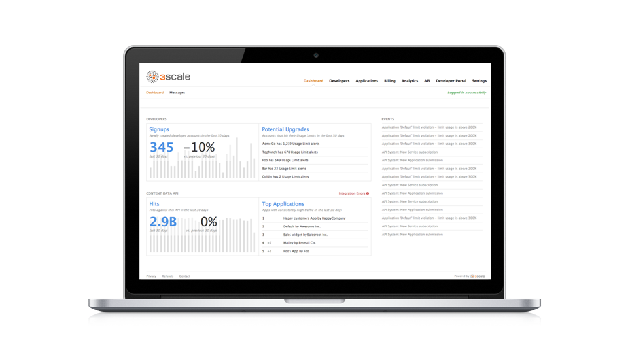

Analytics and reporting
Track and monitor usage. Get reports by API, app, method, and metric.
Notes:
3scale also provides a rich analytics engine that give you the necessary intelligence about the performance of your API, and traffic patterns.
You can choose how fine grained this should be, and get visibility into what application or developer is accessing which API endpoint, and when.
This analytics data can also be exported, and automatic alerts can be created.

Slide 18
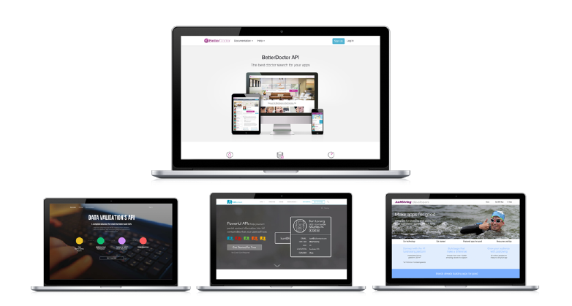

Developer and partner portal
Your brand. Your user experience. Your user interface.
Interactive API documentation
Notes:
One of best ways to increase the adoption of an API is to provide an outstanding developer experience (DX).
A key elements of a good DX is to make it dead-simple to understand and use an API.
3scale customers achieve that via a fully customizable developer portal that supports all the required processes including account and app management, developer analytics, API key management, onboarding and API documentation.
Specifically, 3scale allows developers to examine a live API via the interactive API documentation which is based on Swagger.

Slide 19
3 Scale Applied

Slide 20






COMMON BUSINESS USE CASES / DRIVERS
Essential conversation to focus on what is driving the customer initiatives and interest
Mobile and IOT support
Customer integration
Partner ecosystem
Content and transaction channel
APIs as a business
Internal agility

Slide 21



Schiphol improves the airport passenger experience with Red Hat® JBoss® Fuse and Red Hat 3scale API Management
SOLUTION:
CHALLENGE:
Schiphol chose Red Hat 3scale API Management because the technical integration was frictionless, allowing them to realize the benefits of the industry’s most flexible, scalable, and future-growth-oriented platform for both technical and business operations functionality.
To provide an outstanding customer journey by creating a smart airport experience and facilitating third-party development of mobile apps
To improve internal and external partner operations and more effectively share data with stakeholders
To provide accurate, high quality airport information, such as flight or bag info, from data owned by Schiphol and integrated third parties
RESULTS:
• Improved overall travel experience of customers by use of third-party-developed mobile apps
• Made it easier for partners to customize and extend existing data assets
• Now able to provide comprehensive, high-quality airport information for integration with third parties
“
We want to support the traveler as well as possible with personal and relevant information about the airport. Our API platform and data sharing with APIs is a key element in our best airport digital strategy.
- GARBIS VAN OKBURCHT
I.T. MANAGER, AIRPORT OPERATION SERVICES, AMSTERDAM AIRPORT SCHIPHOL
Notes:
Full story: https://www.redhat.com/en/about/press-releases/amsterdam-airport-schiphol-taps-red-hat-support-goal-becoming-best-digital-airport

Slide 22
Learn more
Visit: https://www.redhat.com/en/technologies/jboss-middleware/3scale
Read: https://www.redhat.com/en/technologies/jboss-middleware/3scale/resources
Try: https://www.3scale.net/

Slide 23
Thank you !

